Slide 1
Paper Reading Sharing
Zekun Cai 20200605

Slide 2
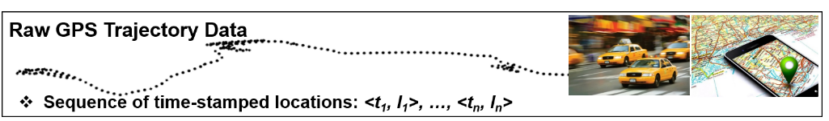
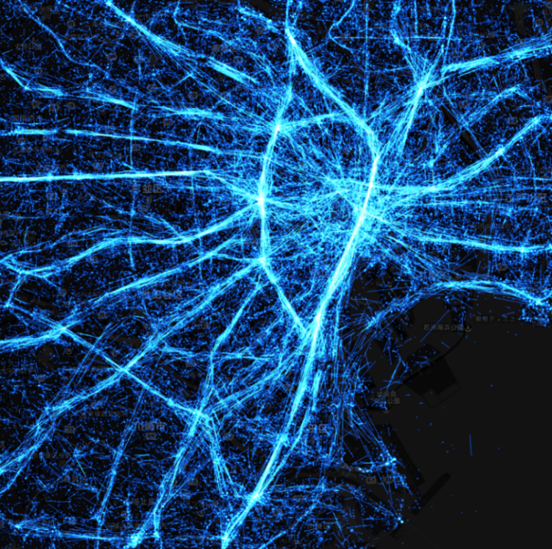
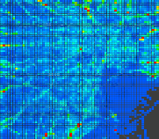
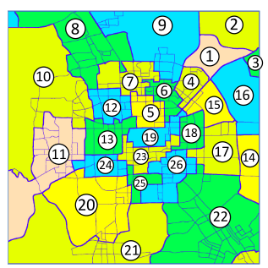
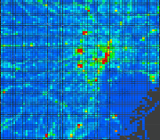
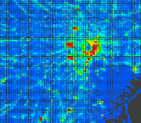
Introduction
Citywide Mobility Computing
Individual
Citywide
Shinjuku
Tokyo
non-Euclidean structure
Euclidean structure
Shibuya
Shinjuku
Shinjuku
Tokyo
Problem
(Video)
Tokyo
Shibuya
Shibuya
(Timestep, Height, Width, Channel)
(Timestep, N, Channel)

Slide 3
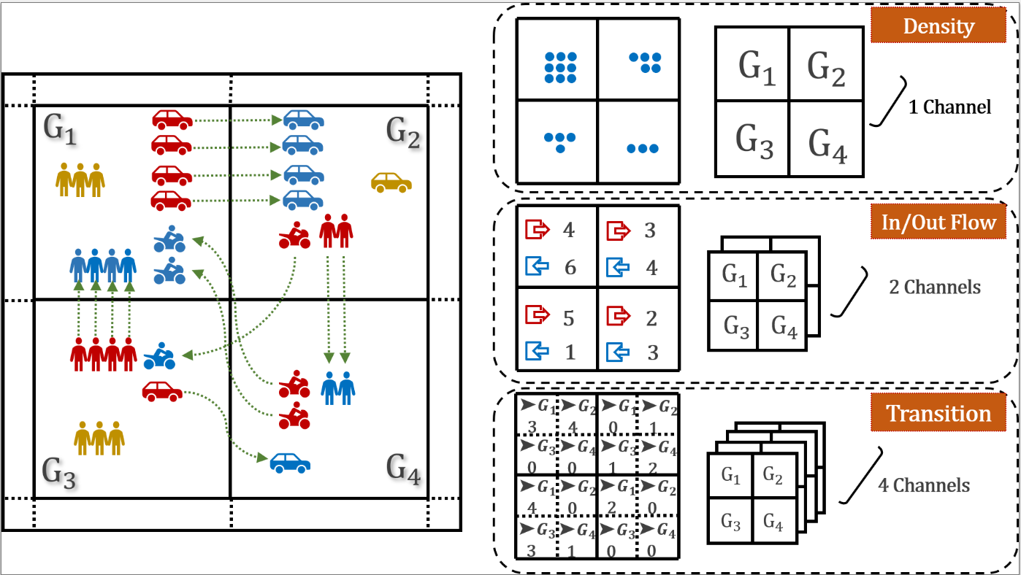
Introduction
Citywide Mobility Computing
Channel: Density, Flow, Speed, Taxi pick-ups……
Application: traffic management, public safety, traffic demand
Euclidean space
Shinjuku
Tokyo
Shibuya
(Timestep, Height, Width, Channel)

Slide 4
Deep Spatio-Temporal Residual Networks for Citywide Crowd Flows Prediction

Slide 5
Deep Spatio-Temporal Residual Networks for Citywide Crowd Flows Prediction
Introduction
Task:
In this paper, we predict two types of crowd flows: inflow and outflow.
Challenge:
Spatial dependencies
Temporal dependencies
External influence
Contributions:
ST-ResNet employs convolution-based residual networks to model nearby and distant spatial dependencies.
temporal properties: closeness, period, and trend
dynamically aggregates the output of the three networks

Slide 6
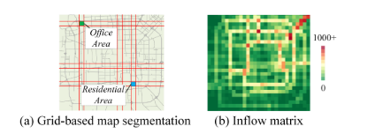
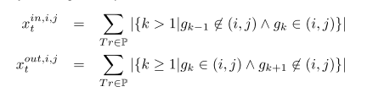
Deep Spatio-Temporal Residual Networks for Citywide Crowd Flows Prediction
Preliminaries
Region
partition a city into an I×J grid map based on the longitude and latitude where a grid denotes a region
Inflow/outflow
Problem
Given the historical observations {Xt|t = 0, · · · , n − 1},
predict Xn
I*J*2
n*I*J*2→ I*J*2

Slide 7
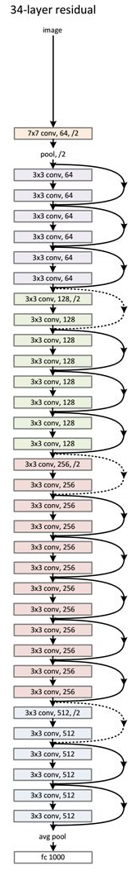
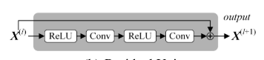
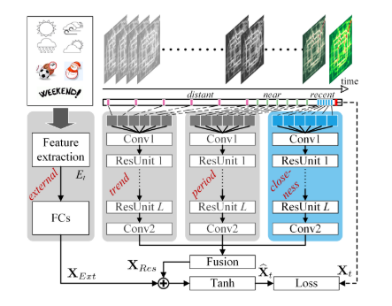
Deep Spatio-Temporal Residual Networks for Citywide Crowd Flows Prediction
Deep Spatio-Temporal Residual Networks
Deep Residual Learning
Overview

Slide 8
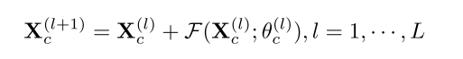
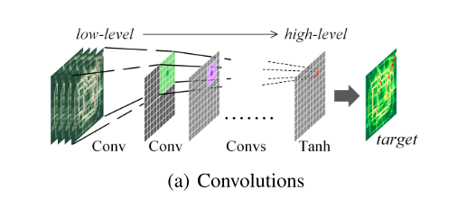
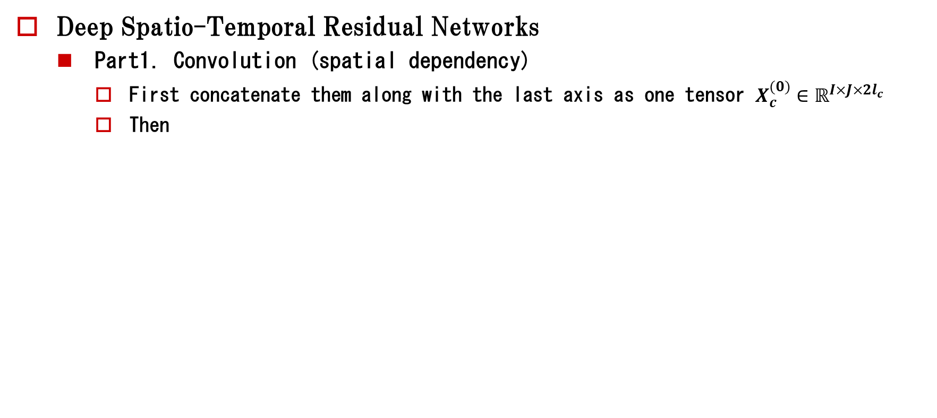
Deep Spatio-Temporal Residual Networks for Citywide Crowd Flows Prediction
Deep Spatio-Temporal Residual Networks
Part1. Convolution (spatial dependency)
First concatenate them along with the last axis as one tensor $X_{c}^{(0)}∈ℝ^{I×J×2l_{c}}$
Then

Slide 9
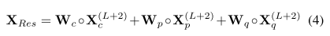
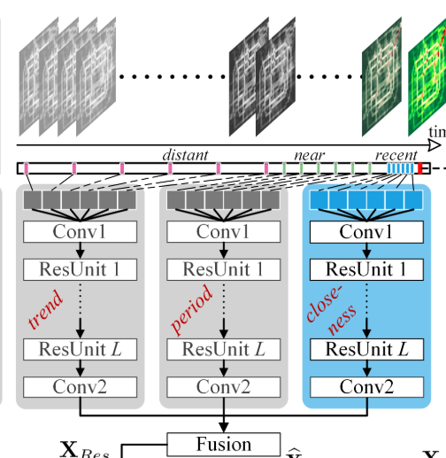
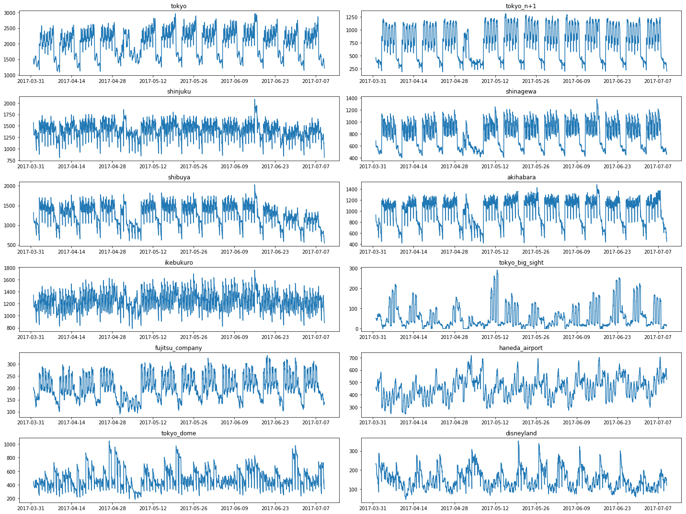
Deep Spatio-Temporal Residual Networks for Citywide Crowd Flows Prediction
Deep Spatio-Temporal Residual Networks
Part2. Three parallel networks (temporal dependency)
closeness, period, trend → most recent, one-day ago, one-week ago
Fusion:

Slide 10
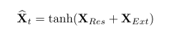
Deep Spatio-Temporal Residual Networks for Citywide Crowd Flows Prediction
Deep Spatio-Temporal Residual Networks
Part3. External Component (external dependency)
Weather, Holiday event, Day of week, Weekday/Weekend
One hot + two fully-connected layers
Final prediction:
Loss: MSE

Slide 11
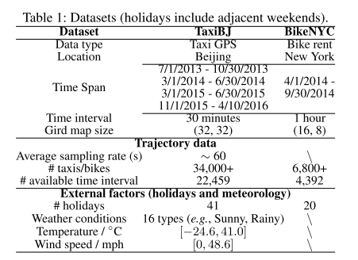
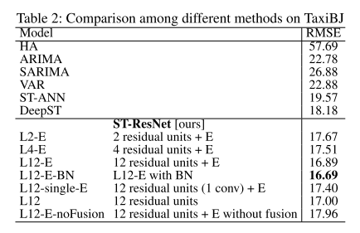
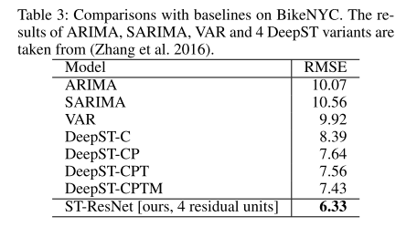
Deep Spatio-Temporal Residual Networks for Citywide Crowd Flows Prediction
Experiments
Data: TaxiBJ and BikeNYC(Table 1)
Evaluation Metric: RMSE
Baselines: HA, ARIMA, SARIMA, VAR, ST-ANN, DeepST
Results: Table2, 3

Slide 12
Spatio-Temporal Graph Convolutional Networks: A Deep Learning Framework for Traffic Forecasting

Slide 13
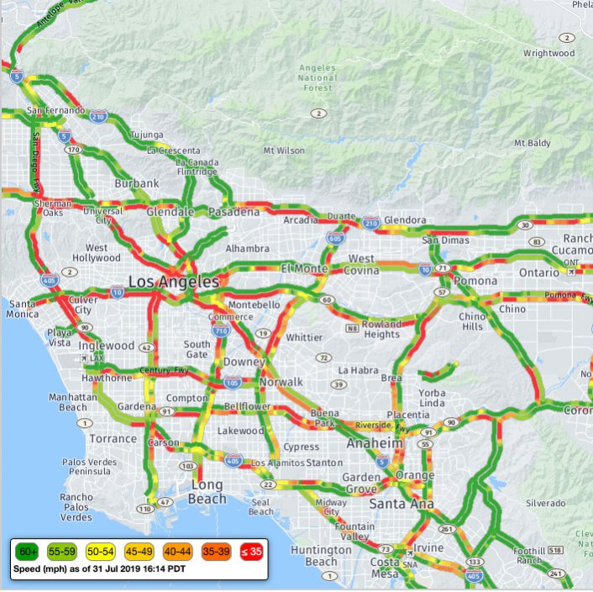
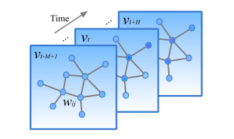
Spatio-Temporal Graph Convolutional Networks: A Deep Learning Framework for Traffic Forecasting
Introduction
Task:
predict graph-structured traffic data
Challenge:
Spatial dependencies
Temporal dependencies
Learning of non-Euclidean data in neural networks
Contributions:
model the traffic network by a general graph
purely convolutional structures to extract spatio-temporal features simultaneously from graph-structured time series

Slide 14
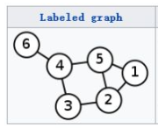
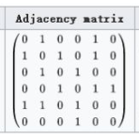
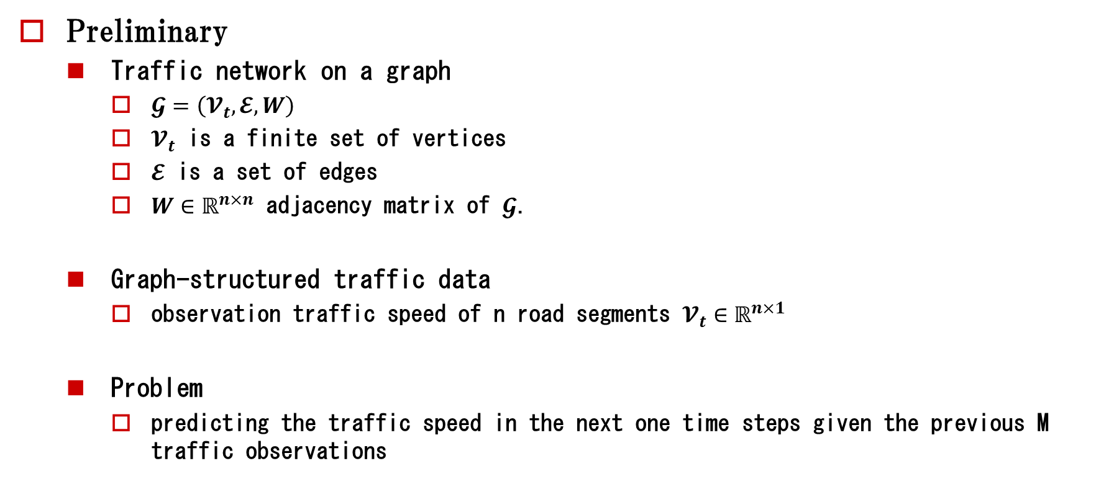
Spatio-Temporal Graph Convolutional Networks: A Deep Learning Framework for Traffic Forecasting
Preliminary
Traffic network on a graph
$𝓖=\left(𝓥_{t},𝓔,W\right)$
$𝓥_{t}$ is a finite set of vertices
$𝓔$ is a set of edges
$W∈ℝ^{n×n}$ adjacency matrix of $𝓖$.
Graph-structured traffic data
observation traffic speed of n road segments $𝓥_{t}∈ℝ^{n×1}$
Problem
predicting the traffic speed in the next one time steps given the previous M traffic observations
n*1
M*n*1→ 1*n*1

Slide 15
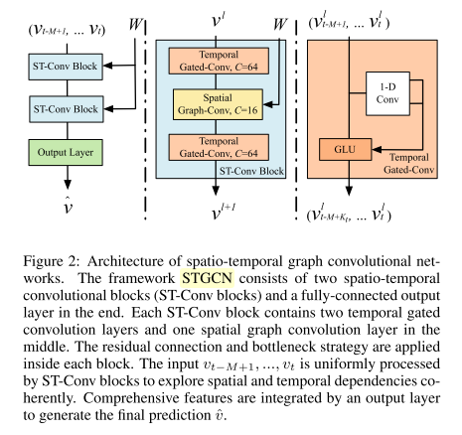
Spatio-Temporal Graph Convolutional Networks: A Deep Learning Framework for Traffic Forecasting
Overview
Framework: 2 ST-Conv blocks + 1 Out layer(temporal gate convolution + FC)
ST-Conv blocks: 2 temporal gated convolution + 1 spatial graph convolution

Slide 16
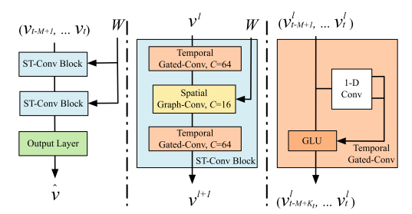
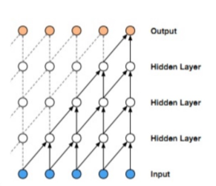
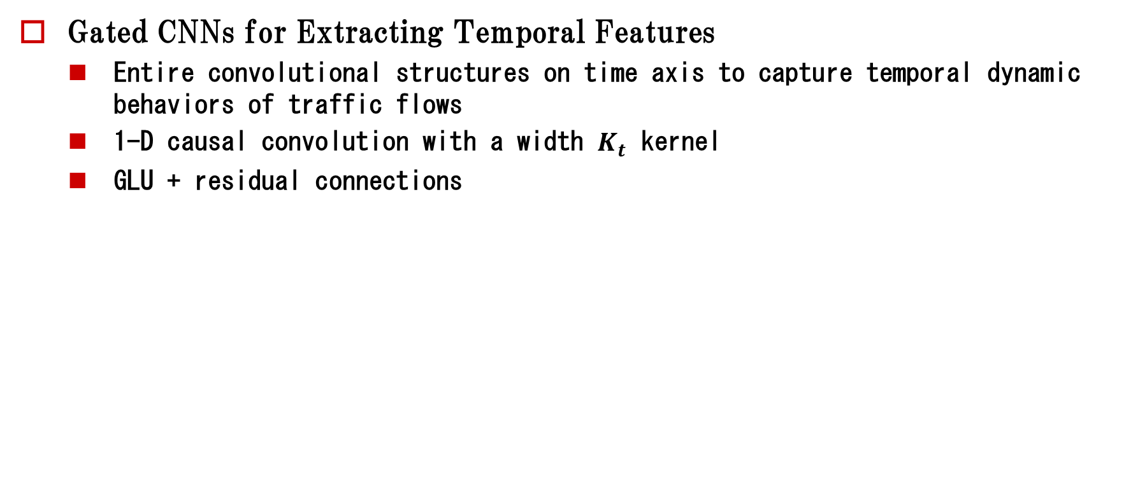
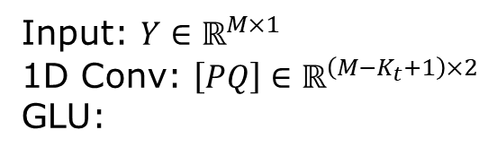
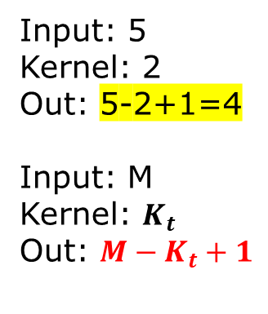
Spatio-Temporal Graph Convolutional Networks: A Deep Learning Framework for Traffic Forecasting
Gated CNNs for Extracting Temporal Features
Entire convolutional structures on time axis to capture temporal dynamic behaviors of traffic flows
1-D causal convolution with a width $K_{t}$ kernel
GLU + residual connections
Input: 5
Kernel: 2
Out: 5-2+1=4
Input: M
Kernel: $K_{t}$
Out: ${M−K}_{t}+1$
Input: $Y∈ℝ^{M×1}$
1D Conv: $\left[PQ\right]∈ℝ^{\left(M−K_{t}+1\right)×2}$
GLU:
1-D convolution on time axis
Gated CNN

Slide 17
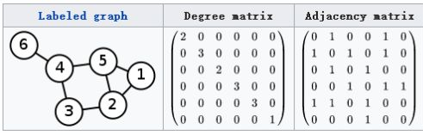
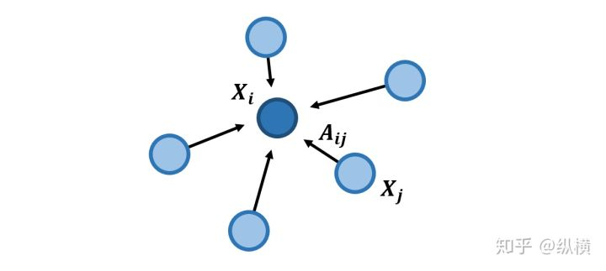
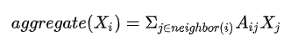
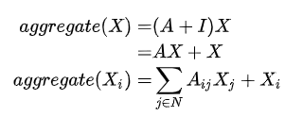
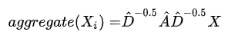
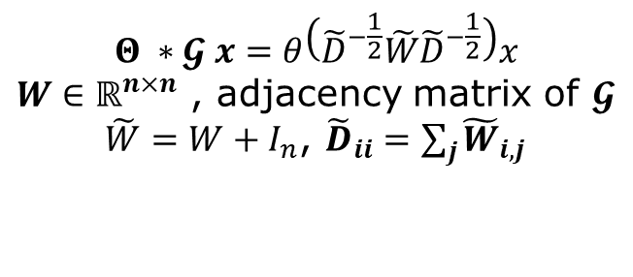
Spatio-Temporal Graph Convolutional Networks: A Deep Learning Framework for Traffic Forecasting
Graph convolution —— Direct understanding
$$Θ ∗𝓖 x=θ\left({\tilde{D}}^{−\frac{1}{2}}\tilde{W}{\tilde{D}}^{−\frac{1}{2}}\right)x$$
$W∈ℝ^{n×n}$ , adjacency matrix of $𝓖$
$\tilde{W}=W+I_{n}$, ${\tilde{D}}_{ii}=\sum_{j}{{\tilde{W}}_{i,j}}$

Slide 18
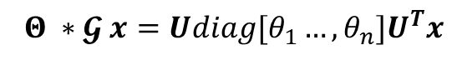
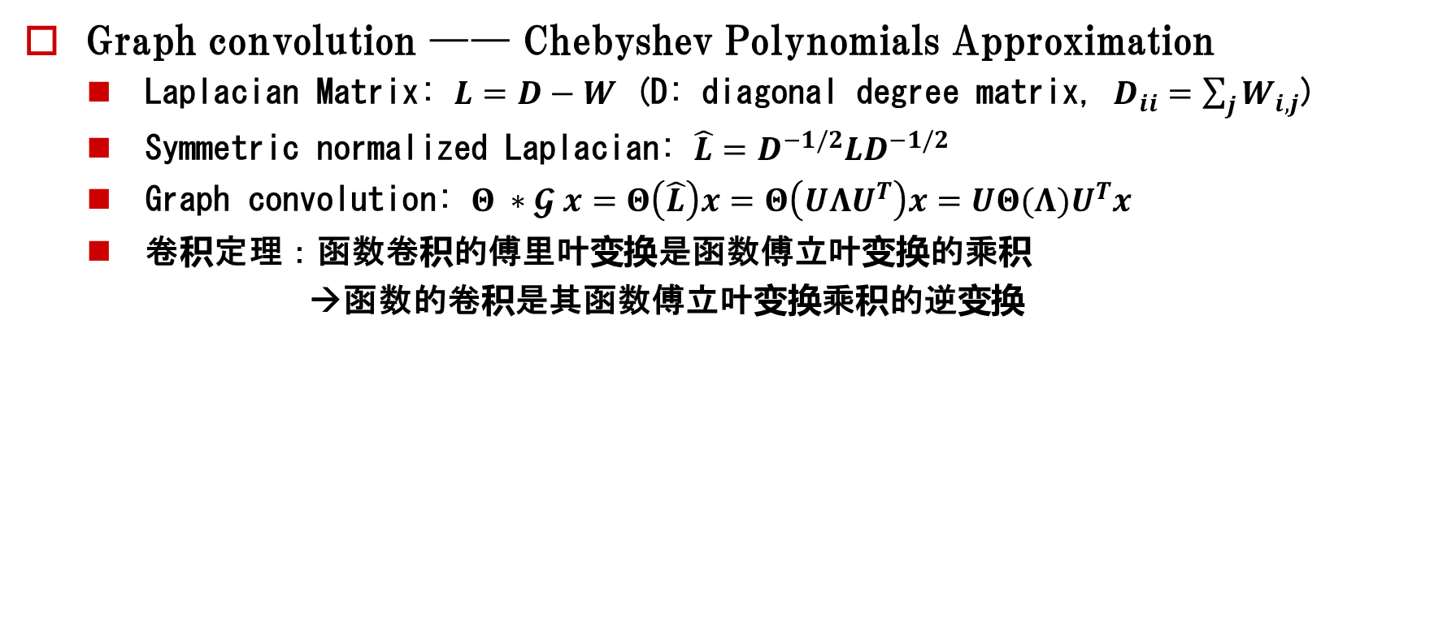
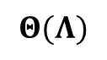
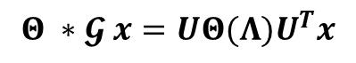
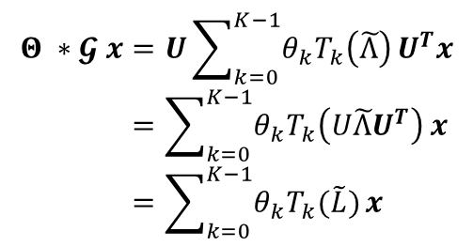
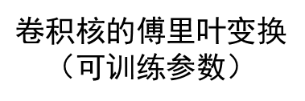
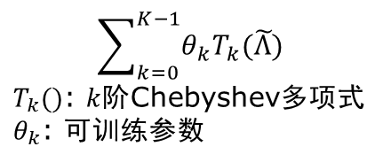
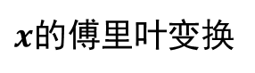
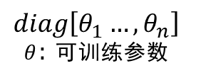
Spatio-Temporal Graph Convolutional Networks: A Deep Learning Framework for Traffic Forecasting
Graph convolution —— Chebyshev Polynomials Approximation
Laplacian Matrix: $L=D−W$ (D: diagonal degree matrix, $D_{ii}=\sum_{j}{W_{i,j}}$)
Symmetric normalized Laplacian: $\hat{L}=D^{−1/2}LD^{−1/2}$
Graph convolution: $Θ ∗𝓖 x=Θ\left(\hat{L}\right)x=Θ\left(UΛU^{T}\right)x=UΘ(Λ)U^{T}x$
卷积定理：函数卷积的傅里叶变换是函数傅立叶变换的乘积
→函数的卷积是其函数傅立叶变换乘积的逆变换
$$diag\left[θ_{1}…,θ_{n}\right]$$
$θ$: 可训练参数
$$Θ ∗𝓖 x=Udiag[θ_{1}…,θ_{n}]U^{T}x$$
傅里叶变换的逆变换
High computational complexity
$$Θ ∗𝓖 x=UΘ(Λ)U^{T}x$$
$x$的傅里叶变换
$$Θ(Λ)$$
$$Θ ∗𝓖 x=U\sum_{k=0}^{K−1}{θ_{k}T_{k}\left(\tilde{Λ}\right)}U^{T}x \\ =\sum_{k=0}^{K−1}{θ_{k}T_{k}\left(U\tilde{Λ}U^{T}\right)}x \\ =\sum_{k=0}^{K−1}{θ_{k}T_{k}(\tilde{L})}x$$
$$\sum_{k=0}^{K−1}{θ_{k}T_{k}(\tilde{Λ})}$$
$T_{k}()$: $k$阶Chebyshev多项式
$θ_{k}$: 可训练参数
$卷积核$的傅里叶变换
（可训练参数）

Slide 19
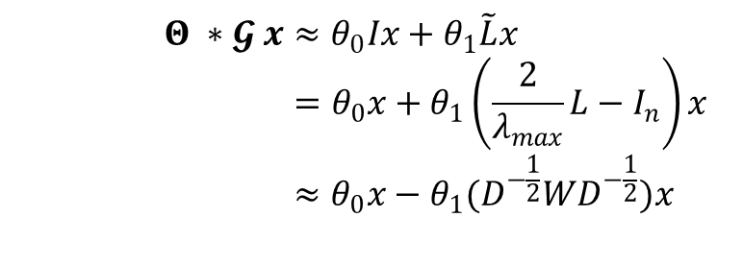
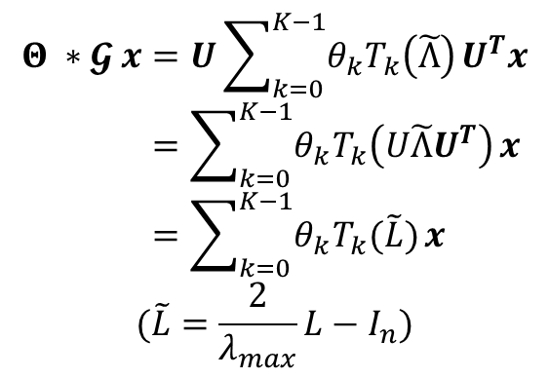


Spatio-Temporal Graph Convolutional Networks: A Deep Learning Framework for Traffic Forecasting
Graph convolution —— 1st-order Approximation
$$Θ ∗𝓖 x≈θ_{0}Ix+θ_{1}\tilde{L}x \\ =θ_{0}x+θ_{1}\left(\frac{2}{λ_{max}}L−I_{n}\right)x \\ ≈θ_{0}x−θ_{1}(D^{−\frac{1}{2}}WD^{−\frac{1}{2}})x$$
$$Θ ∗𝓖 x=U\sum_{k=0}^{K−1}{θ_{k}T_{k}\left(\tilde{Λ}\right)}U^{T}x \\ =\sum_{k=0}^{K−1}{θ_{k}T_{k}\left(U\tilde{Λ}U^{T}\right)}x \\ =\sum_{k=0}^{K−1}{θ_{k}T_{k}(\tilde{L})}x$$
$$(\tilde{L}=\frac{2}{λ_{max}}L−I_{n})$$
1st-order Approximation
Let $θ=θ_{0}={−θ}_{1}$
$$Θ ∗𝓖 x=θ\left(I_{n}+D^{−\frac{1}{2}}WD^{−\frac{1}{2}}\right)x \\ =θ\left({\tilde{D}}^{−\frac{1}{2}}\tilde{W}{\tilde{D}}^{−\frac{1}{2}}\right)x$$
Applying a stack of graph convolutions with the 1st-order approximation vertically that achieves the similar effect as K- localized convolutions do horizontally.

Slide 20
Spatio-Temporal Graph Convolutional Networks: A Deep Learning Framework for Traffic Forecasting
Overview
Framework: 2 ST-Conv blocks + 1 Out layer(temporal gate convolution + FC)
ST-Conv blocks: 2 temporal gated convolution + 1 spatial graph convolution

Slide 21
Spatio-Temporal Graph Convolutional Networks: A Deep Learning Framework for Traffic Forecasting
Experiments
BJER4
gathered from the major areas of east ring No.4 routes in Beijing City by double-loop detectors
12 roads selected for our experiment
2014/7/1~2014/8/31
PeMSD7
collected from Caltrans Performance Measurement System (PeMS) in real-time by over 39, 000 sensor stations, deployed across the major metropolitan areas of California state highway system.
randomly select a medium(228) and a large(1026) dataset for experiment.
2012/5/1~2012/6/30
Time interval: 5min
12 observed data points (M = 12), forecast traffic conditions in the next 15, 30, and 45 minutes (H =3, 6, 9)

Slide 22

Spatio-Temporal Graph Convolutional Networks: A Deep Learning Framework for Traffic Forecasting
PeMSD7

Slide 23


Spatio-Temporal Graph Convolutional Networks: A Deep Learning Framework for Traffic Forecasting
Experiments
Achieve the best performance in all evaluation metrics
STGCN(Cheb) with K=3 better than STGCN(1st)

